Slide 1
Medical Council of Canada Exam Changes
The MCCEE will be phased out; the last session will be November 2018
As of application for the 2019 MCCQE Part 1, the MCCEE will not be a pre-requisite for IMGs to take the MCCQE Part I
As of March 2018 , the MCCEE will not be a pre-requisite for IMGs to take the National Assessment Collaboration (NAC) exam session
1/7

Slide 2
MCC: NAC-OSCE Changes
Starting March 2018, candidates will be able to retake the NAC Examination if they have a pass (or fail) result, for up to three attempts in all (but will have to skip a session before re-applying)
IMGs may take the NAC exam within 12 months of their anticipated date of graduation
2/7

Slide 3
MCC – Other Changes
More opportunities to take and retake the MCCQE Part 1 – four to five times per year vs the current 2x/year
New preparatory materials
Changes to both MCCQE Part 1 and Part 2 exams will focus on health promotion, illness prevention and psychosocial factors, communication with patient families, other HC professionals, and with colleagues.
A new passing standard to be implemented as of the Spring 2018 MCCQE Part 1 and Fall 2018 MCCQE Part 2 sessions.
3/7

Slide 4
MCC Exam Changes – WHY?
Need for more opportunities to take and retake the MCCQE Part 1 and need to simplify the evaluation process for IMGs
Additional preparatory material for the MCCQE Part 1 and Part 2
A re-examination of the purpose and mandate of the NAC exam
The new MCC assessment Blueprint and the Assessment Evolution address these concerns and the Council received funding of $6.7 million from federal government to make the changes
4/7

Slide 5
MCC Preparatory Resources
To mitigate the higher level of difficulty compared to the current MCCEE, IMGs will be supported by new preparatory material which will include:
A multiple-choice questions test and clinical decision making test – Each test will represent a sampling of the MCCQE Part 1.
Preparatory Examinations – complete MCCQE Part 1 test forms that will simulate the exam experience, and provide candidates with question-level feedback
Orientation self-study program on topics such as communication and cultural competency as well as the ethical, legal, and organizational aspects of medicine
The orientation self-study program is currently available on physiciansapply.ca, while the new multiple-choice questions test, clinical decision making test and Preparatory Examinations will be made available on mcc.ca starting in 2018.
5/7

Slide 6
Issues for Residency and Fellowship Program Directors
Equity, Timing, Licensing
Comparison of
- candidates with scores from the new MCCQE1 vs “old” MCCQE1
- MCCEE vs new MCCQE1
- old vs new NAC-OSCE
If an IMG has written the MCCEE previously, are they exempt from the new MCCQE1
Will the CPSO still accept the MCCEE after “phase-out”
Can those who already have the MCCEE also write the new MCCQE1 if they wish
Will IMGs who take the MCCQE1 in early 2019 have any issues with receiving their results before application deadlines
6/7

Slide 7
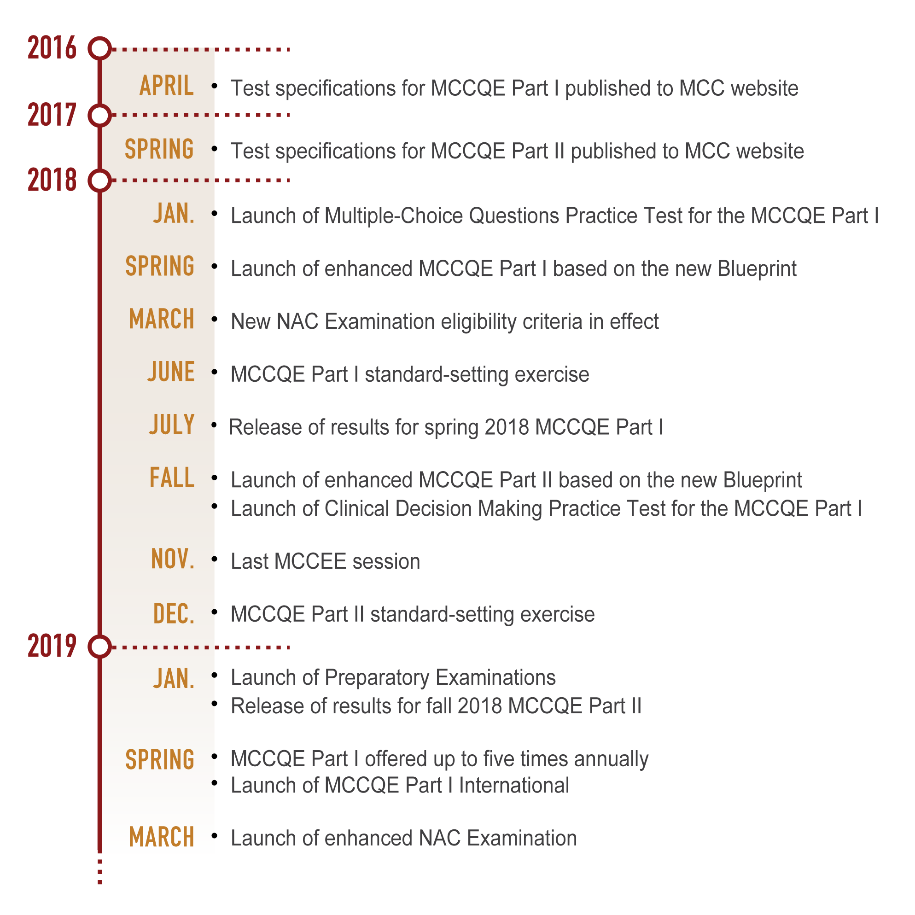
7/7

