Slide 2
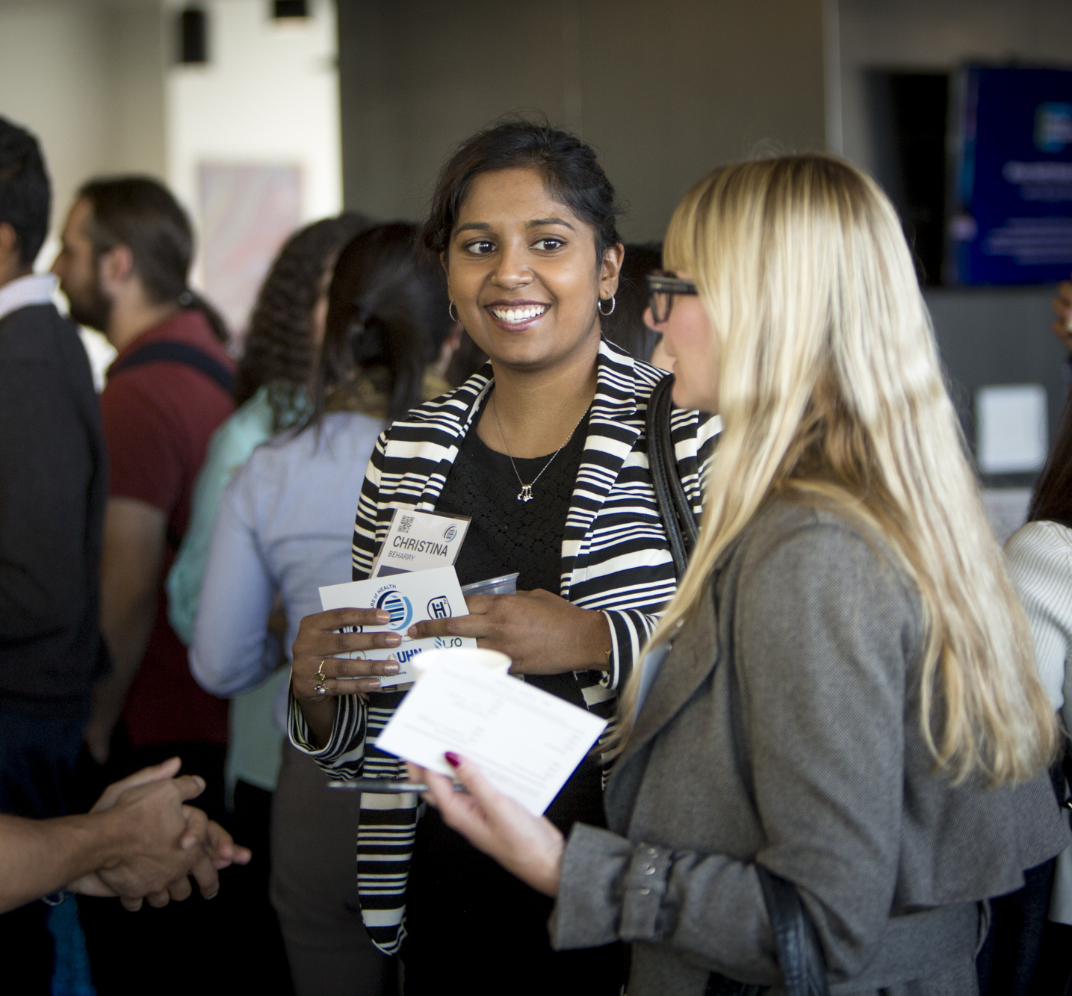
Translation:
In health sciences refers to the application of scientific knowledge to improve medicine, health and care.
It may involve developing novel tools, mechanisms, services, drugs, techniques, policies, and protocols that address the needs of people and populations.

Slide 3
Our Mission:
To challenge students to think differently, so they can champion change in their communities and contexts.

Slide 4
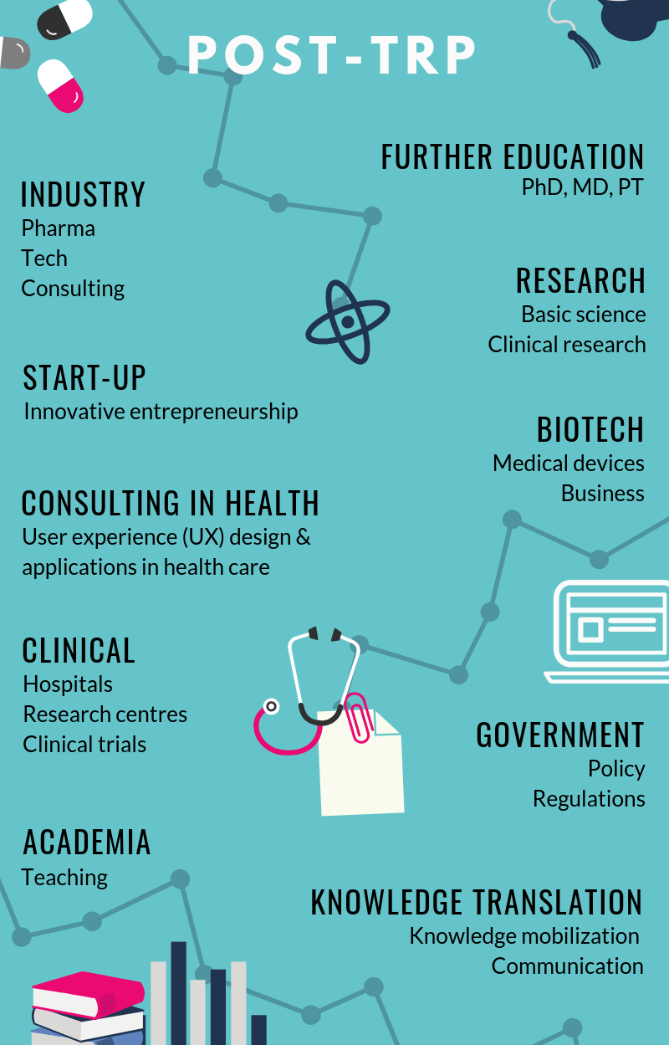
TRP is…
A competency-based GRAD program focused on transferable skills…
Experiential Learning
Networking
Project Management
Facilitated learning
Individual Development
Leadership & Collaboration
Flexible programming
Modules &Electives
Creative Problem-solving
… to build your career.

Slide 5
Our Program
A 2-year professional experiential-learning based Masters of Health Science that provides:
Our Andragogy:
Learner-driven: we facilitate—we don’t lecture.
Experiential--learn by doing.
Process focused (not assessment-based).
a foundation of knowledge related to translation in health science innovation;
strategies and skills to improve translational thinking, problem-solving, and creativity; and
access & opportunities for practice, development and collaboration.

Slide 6
Our Program

Slide 7
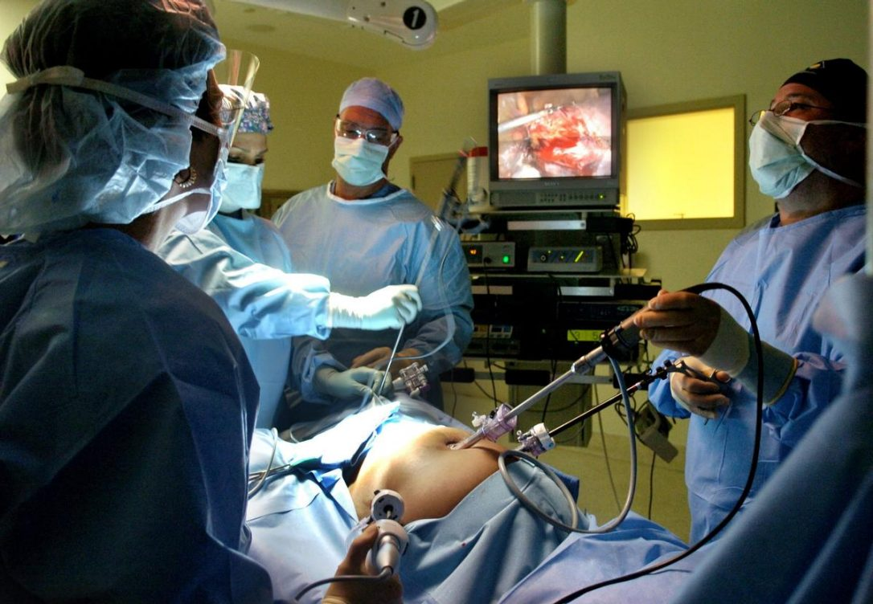
Translation in Action – Student Publications

Slide 8
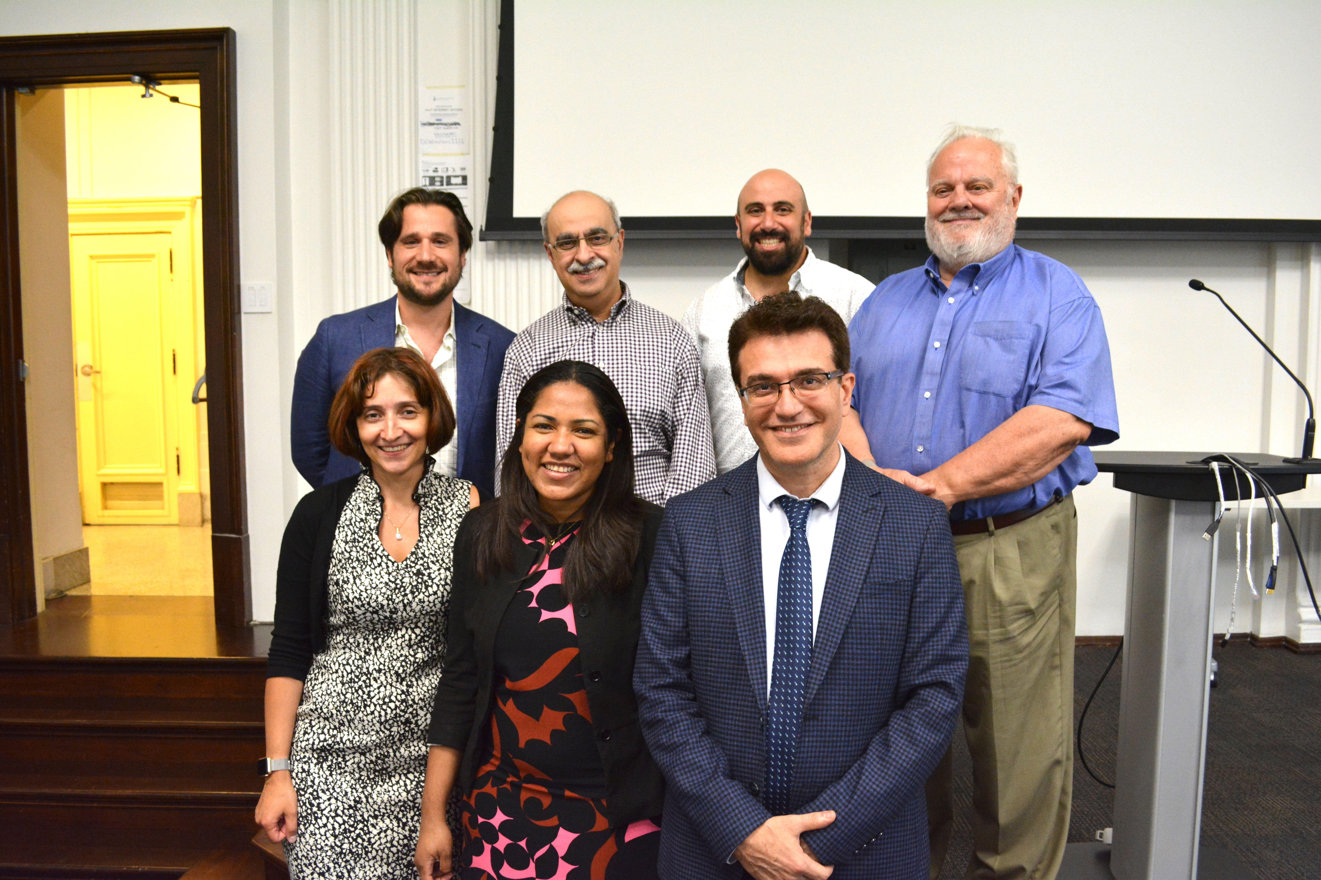
Translation in Action:
Impact on Real World Challenges
Refractory Incontinence in Children
Unmet Medical Need:
Incontinence has major psychological, physiological, and financial implications for children and their families. Although most patients will improve with behavioural therapy and medication, 1% of patients will become refractory, not responding to any treatment
Project:
Explore unused therapies that will help children suffering from severe refractory incontinence that align with the needs and preferences of parents and their children.

Slide 9
“The translational paradigm of the TRP has revolutionized my thinking.” - Clyde

Slide 10
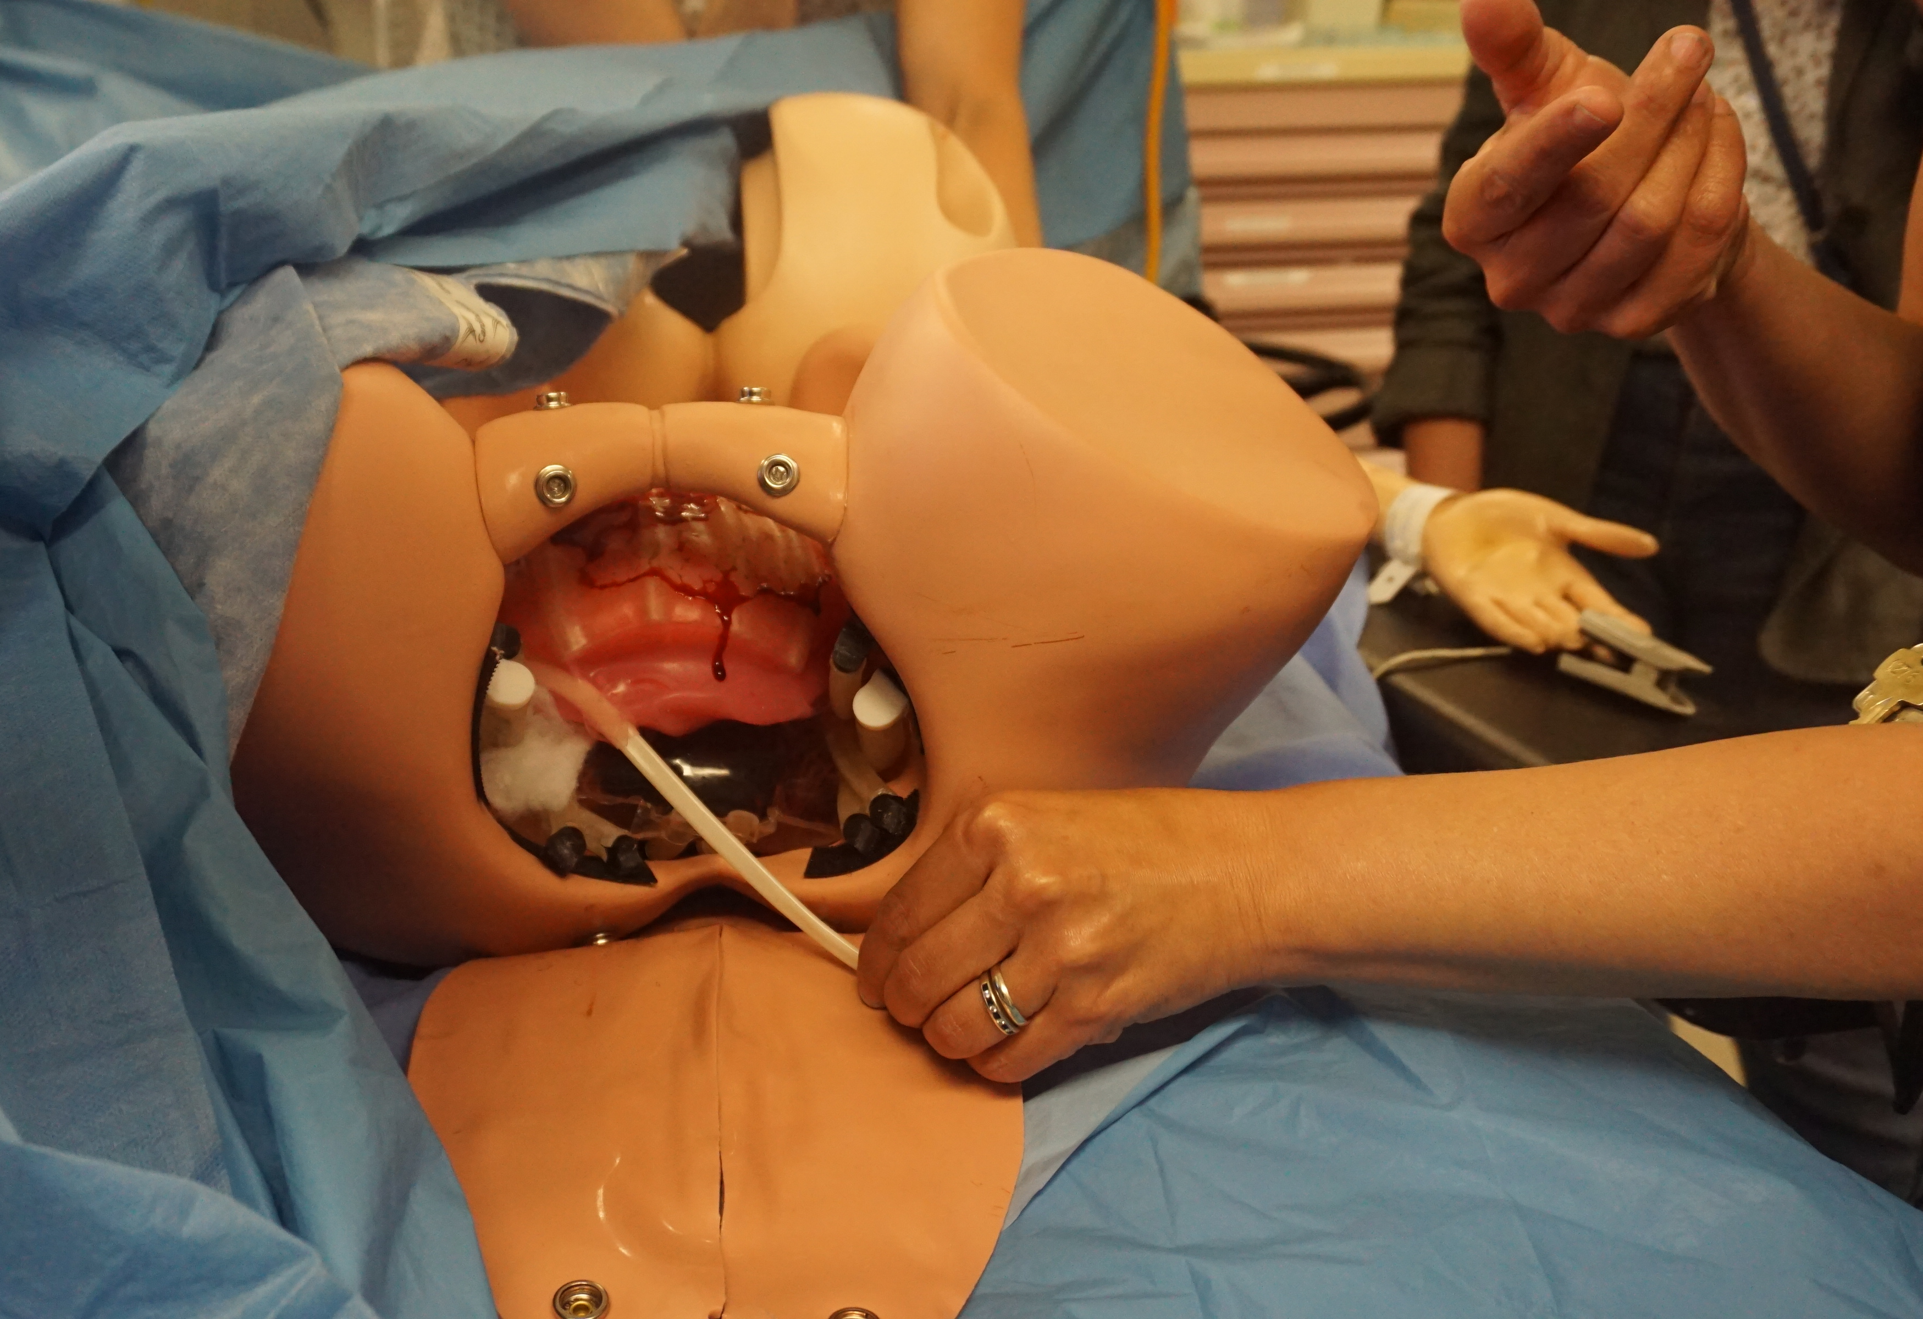
Translation in Action:
Impact on Real World Challenges
Invasive Placentation
Unmet Medical Need:
Management of invasive placentation is medically and surgically complex. Few opportunities exist for healthcare professionals who provide maternity care to gain expertise in invasive placentation.
Project:
Collaborated with clinicians at Mount Sinai and St Michael’s Hospital, as well as the St. Mike’s Surgical Simulation Team within the Li Ka Shing Knowledge Institute to develop a simulation tool using 3D printing that is now being used for medical training.

Slide 11
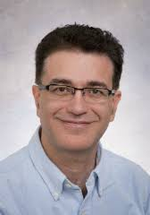
“I’ve done research a certain way for many years but this program has taught me how to efficiently and effectively move forward in an innovative way.” -Reza
Many of our clinical trainees (residents, fellows & faculty) have developed amazing projects.
However, it takes time to reframe their thinking and approach and then work on executing a sophisticated translational research initiative.

Slide 12
Ask: explore Opportunities
For new program pathways to improve the depth and impact of the TRP program for trainees.
E.g. One model: to is spread protected time over two years allowing trainees maintain a portion of their clinical responsibilities while in the TRP.
This will provide more time to develop and execute impactful capstone projects.

Slide 13
Contact:
Joseph Ferenbok,
joseph.ferenbok@utoronto.ca Tel: 416-978-4474
http://trp.utoronto.ca/

